Slide 1
CRYPTOGRAPHY
Cryptography is technique of securing information and communications through use of codes so that only those person for whom the information is intended can understand it and process it. Thus preventing unauthorized access to information.
The prefix “crypt” means “hidden” and
suffix graphy means “writing”.

Slide 2
FEATURSES OF CRYPTOGRAPHY:
Confidentiality: Information can only be accessed by the person for whom it is intended and no other person except him can access it.
Integrity: Information cannot be modified in storage or transition between sender and intended receiver without any addition to information being detected.
Non-repudiation: The creator/sender of information cannot deny his intention to send information at later stage.
Authentication: The identities of sender and receiver are confirmed. As well as destination/origin of information is confirmed.

Slide 3
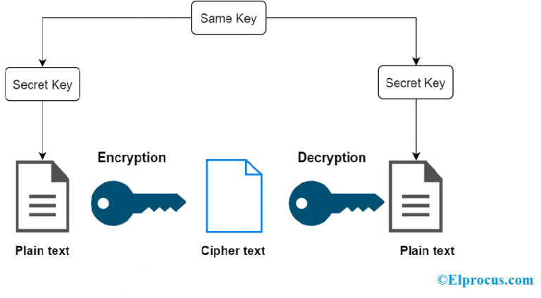
CRYPTOGRAPHY TECHNIQUES
Symmetric Key Cryptography – This is also termed as Private or Secret key cryptography.
Here, both the information receiver and the sender make use of a single key to encrypt and decrypt the message.

Slide 4
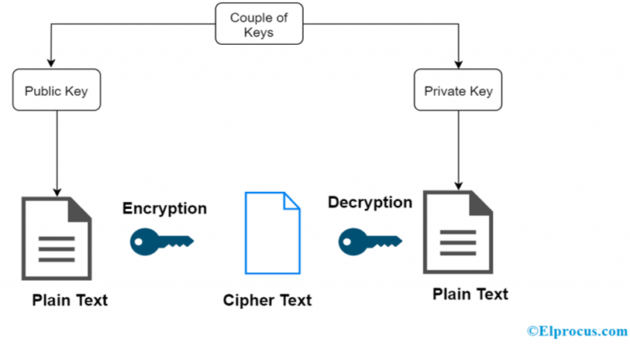
Asymmetric key cryptography
Asymmetric cryptography, also known as public-key cryptography, is a process that uses a pair of related keys -- one public key and one private key -- to encrypt and decrypt a message and protect it from unauthorized access or use.
When someone wants to send an encrypted message, they can pull the intended recipient's public key from a public directory and use it to encrypt the message before sending it. The recipient of the message can then decrypt the message using their related private key.

Slide 5
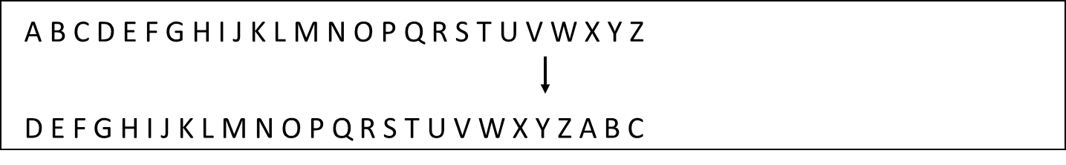
Substitution cipher
A substitution cipher is a type of encryption where characters or units of text are replaced by others in order to encrypt a text sequence.
Caesar cipher
In cryptography, a Caesar cipher, also known as Caesar's cipher, the shift cipher, Caesar's code or Caesar shift, is one of the simplest and most widely known encryption techniques. It is a type of substitution cipher in which each letter in the plaintext is replaced by a letter some fixed number of positions down the alphabet. For example, with a left shift of 3, D would be replaced by A, E would become B, and so on.

Slide 6
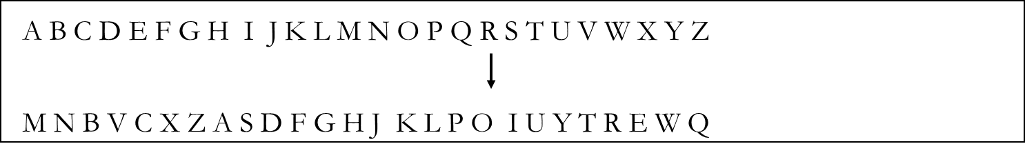
Monoalphabetic cipher
A monoalphabetic substitution cipher, also known as a simple substitution cipher, relies on a fixed replacement structure. That is, the substitution is fixed for each letter of the alphabet. Thus, if "a" is encrypted to "R", then every time we see the letter "a" in the plaintext, we replace it with the letter "R" in the ciphertext.

Slide 7
Polyalphabetic substitution
In polyalphabetic substitution ciphers, the plaintext letters are enciphered differently based upon their installation in the text. Rather than being a one-to-one correspondence, there is a one-to-many relationship between each letter and its substitutes.
For example, ‘a’ can be enciphered as ‘d’ in the starting of the text, but as ‘n’ at the middle. The polyalphabetic ciphers have the benefit of hiding the letter frequency of the basic language. Therefore attacker cannot use individual letter frequency static to divide the ciphertext.

Slide 8
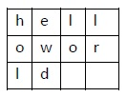
Transposition Cipher
Transposition Cipher is a cryptographic algorithm where the order of alphabets in the plaintext is rearranged to form a cipher text. In this process, the actual plain text alphabets are not included.
Example
A simple example for a transposition cipher is columnar transposition cipher where each character in the plain text is written horizontally with specified alphabet width. The cipher is written vertically, which creates an entirely different cipher text.
Consider the plain text hello world, and let us apply the simple columnar transposition technique as shown below

Slide 9
The plain text characters are placed horizontally and the cipher text is created with vertical format as : holewdlo lr.

